Slide 1
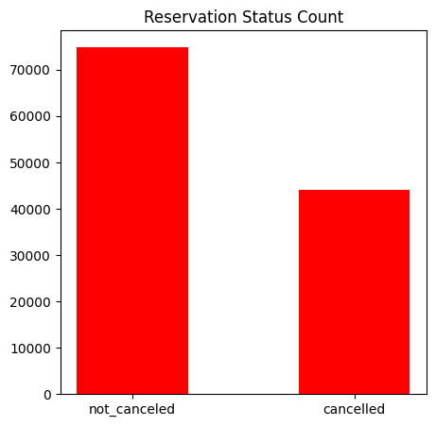
HOTEL BOOKING ANALYSIS
Reservation Status Count :
The accompanying bar graph shows the percentage of reservations that are canceled and those that are not .
It is obvious that there are still a significant number of reservations that have been canceled There are still 37% of clients who canceled their reservations which has a significant impact on the hotels Earnings.

Slide 2
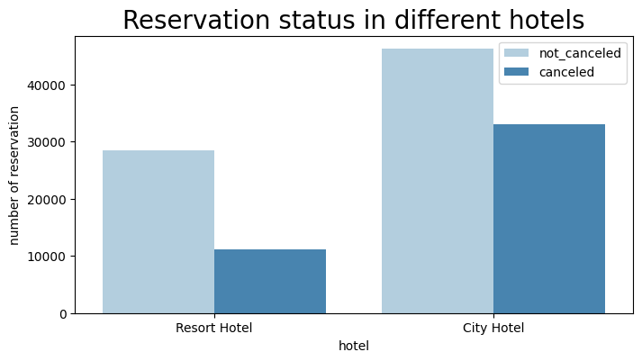
Reservation Status In Different Hotels
In Comparison to resort hotels city hotels have more bookings.
Its possible that resort hotels are more expensive than those in cities.

Slide 3
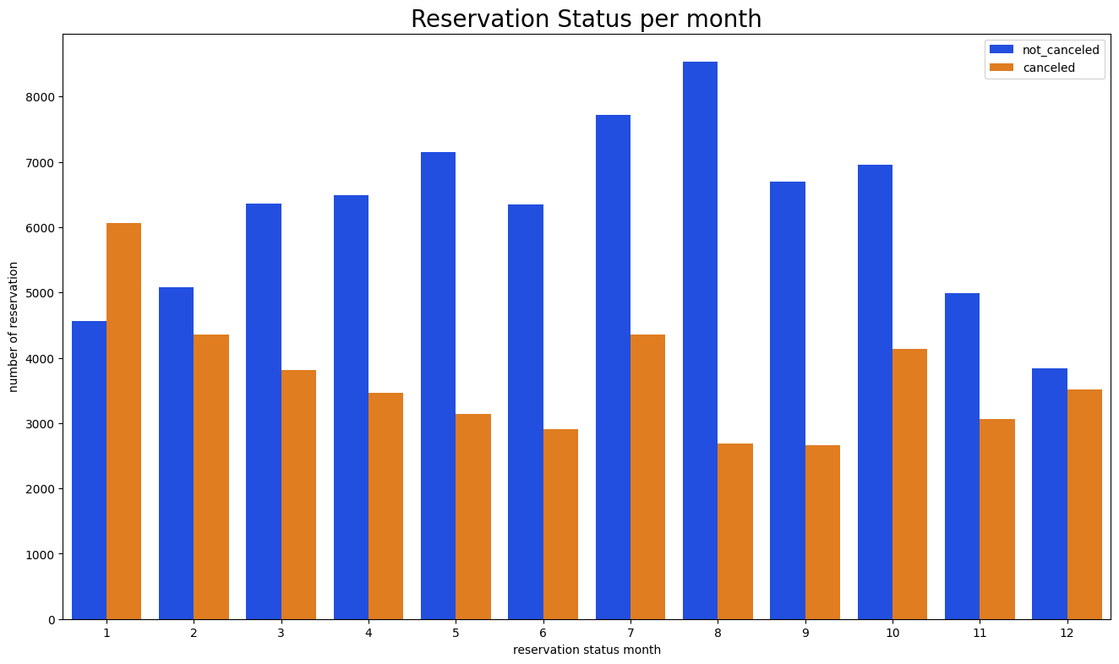
Reservation Status Per Month :
We have developed the grouped bar graph to analyze the months with the highest and lowest reservation levels according to reservation status. As can be seen both the number of confirned reservations and the number of canceled reservations are largest in month of August where as January is the month with the most canceled reservations.

Slide 4
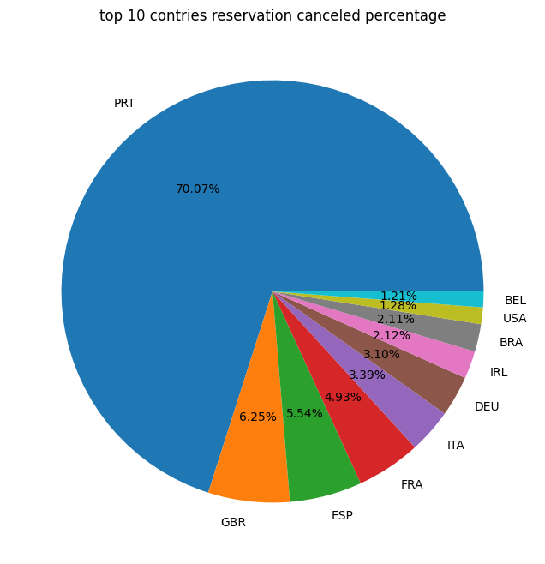
Top 10 Countries Reservation Canceled Percentage :
Portugal stands out as the country with the highest reservation cancellation percentage, accounting for 70.07% of all cancellations. This suggests a significant level of uncertainty or changing plans among individuals who booked hotels in Portugal.
Following Portugal, the United Kingdom has a cancellation percentage of 6.25%. This indicates a relatively lower but still notable rate of cancellations compared to other countries in the dataset.
Spain and France have cancellation percentages of 5.54% and 4.93%, respectively.

Slide 5
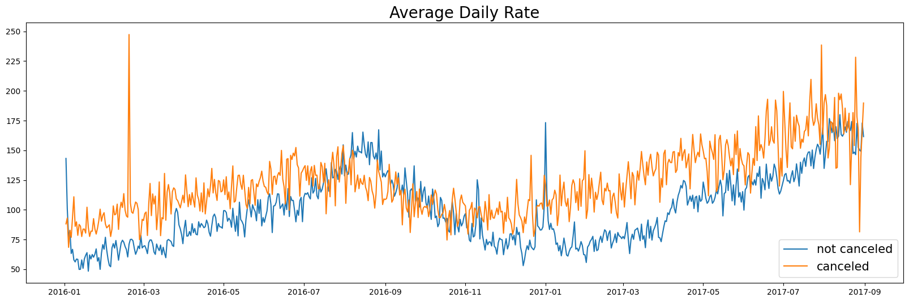
Cancelation By The Average Daily Rate (2016 – 2017) :
As seen in the graph reservations are canceled when the average daily rate is higher thab when it is not canceled.
It clearly proves all the above analysis that the higher price leads to higher cancellation.

